Slide 1
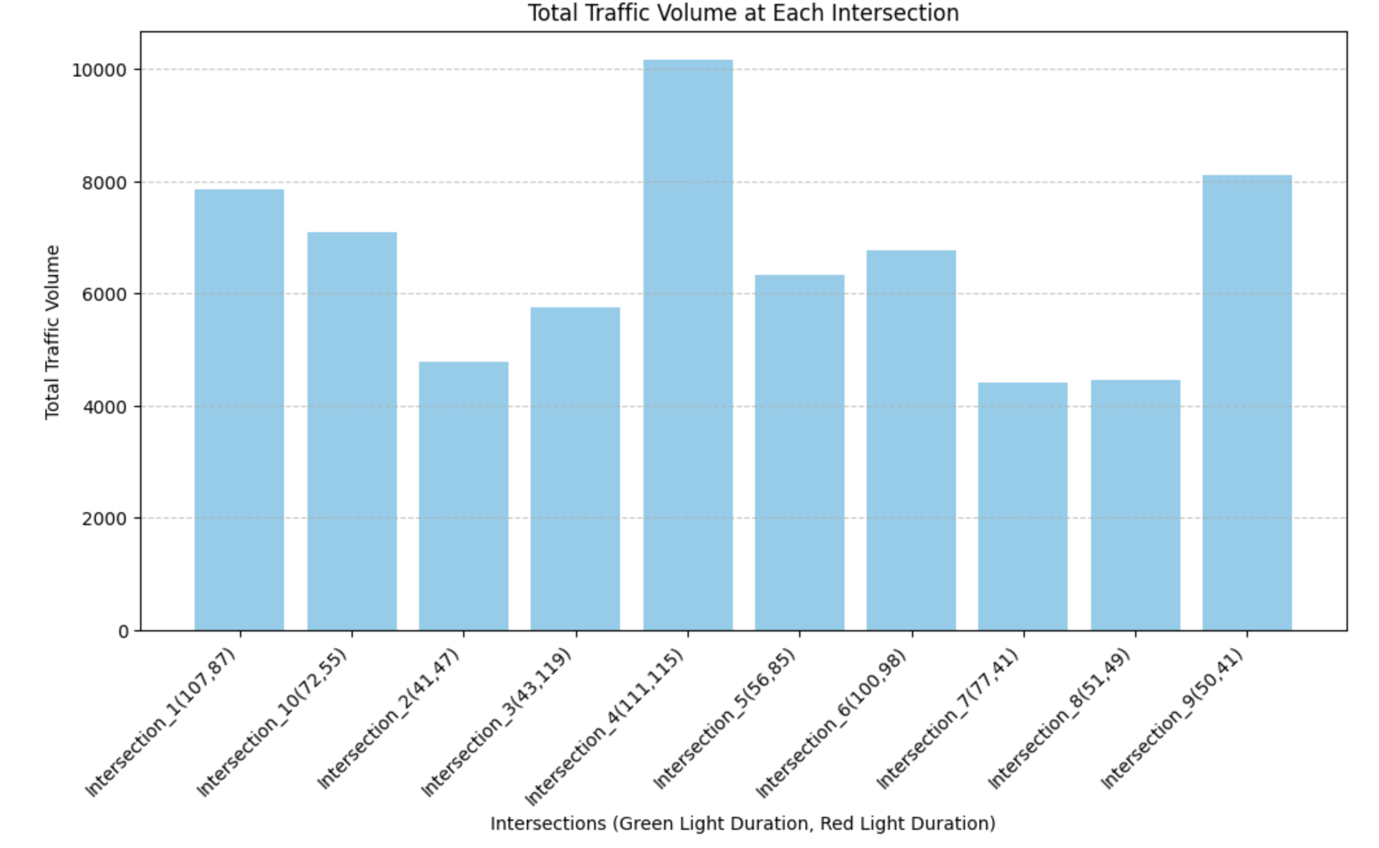
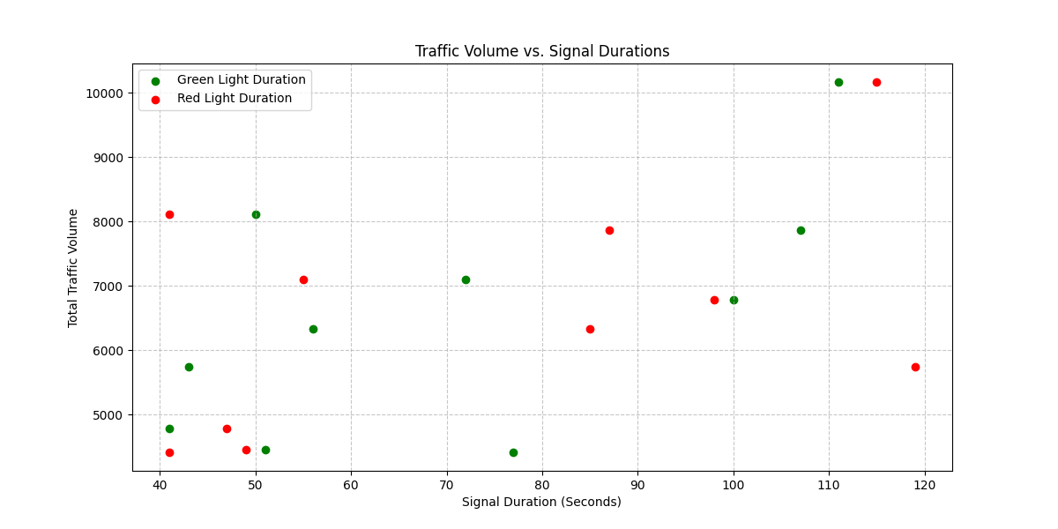
Traffic Signal Timings Overview
Traffic Signal Timings Overview
Green Light Duration:
Ranges from 41 to 111 seconds.
Red Light Duration:
Ranges from 47 to 119 seconds.
Optimization Strategies:
Dynamic Traffic Signal Adjustments
Implement Adaptive Traffic Control Systems (ATCS) to modify signal timings in real-time based on congestion levels.
Extend green light duration at high-traffic intersections during peak hours.
Traffic Signal Synchronization (Green Wave Strategy)
Technique: Coordinate green lights across multiple intersections to create a smooth traffic flow. How?
Reduce stop-and-go movements by allowing cars to pass multiple signals without stopping.
Example: If Intersection_4 → Intersection_5 → Intersection_6 have high traffic at Hour 7 , synchronize green lights to let vehicles move continuously.

Slide 2
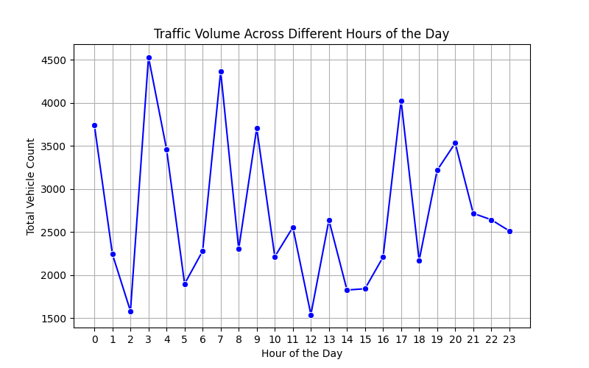
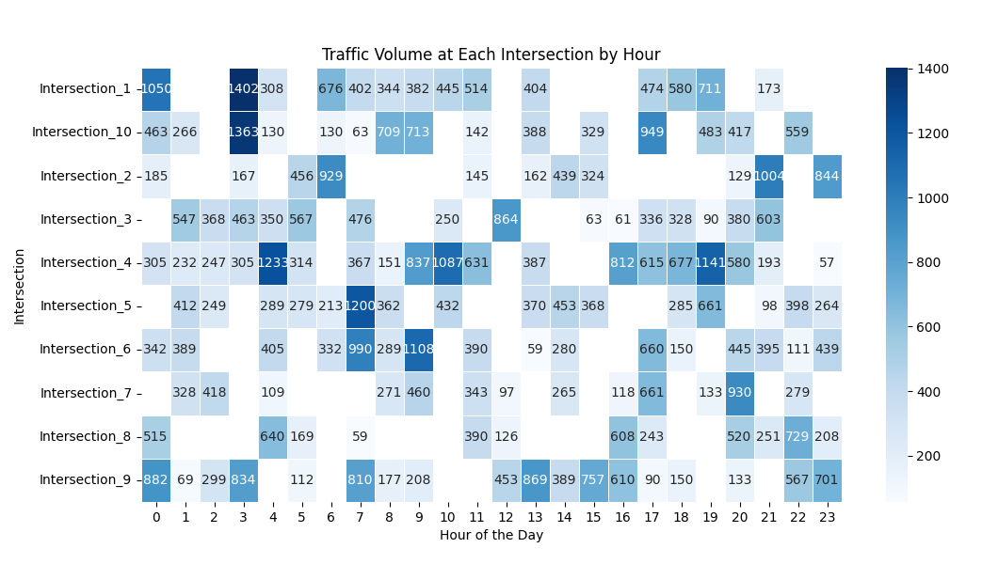
Traffic Flow Data Overview
Traffic Flow Data Overview
Peak Congestion Periods:
Morning Peak: 7 AM - 10 AM
Evening Peak: 5 PM - 8 PM
Busiest Intersections:
Certain intersections experience significantly higher congestion.
Optimization Strategies:
Extend green light duration by 20-30% during peak traffic hours at:
Intersection_1 (Hour 3)
Intersection_10 (Hour 3)
Intersection_4 (Hour 4)
Intersection_5 (Hour 7)
Intersection_6 (Hour 9)
Redistribute Traffic:
Redirect traffic away from most congested intersections(Intersection_4 and Intersection_9) by encouraging alternative routes.
Adjust metro timings to match the congested hours for various intersections(Intersection_1 around Hour 3, Intersection_4 around Hour 4)
Source: https://github.com/ShivamSultaniya/Urban-Traffic-Flow-Optimization.git

Slide 3
Optimization Strategies
1. Adjusting Traffic Signal Timings Dynamically
Implement Adaptive Traffic Control Systems (ATCS) that adjust signals in real-time based on congestion data.
Increase green light duration at high-traffic intersections during peak hours.
Reduce red light duration where long waiting times are causing bottlenecks.
2. Infrastructure & Intersection Optimization
Optimize intersection layouts by adding dedicated lanes for high-traffic vehicle types (e.g., company buses and two-wheelers).
Improve signage and lane discipline to reduce unnecessary lane switching.
3. Encouraging Public Transport & Ride-Sharing
Coordinate traffic signals with Chennai Metro Rail schedules to reduce reliance on private cars.
Promote staggered work hours in IT companies to spread peak traffic over a longer duration.
4. Deploying AI-Based Traffic Prediction
Use historical data to predict congestion and adjust traffic management strategies proactively.
Conclusion
By leveraging data-driven traffic optimization strategies, we can significantly improve traffic conditions in Madhavaram's IT hub. Implementing adaptive signal control, enhancing infrastructure, promoting public transport, and deploying AI-based traffic prediction will collectively reduce congestion, lower travel times, and create a more efficient urban commuting experience.

